Slide 1
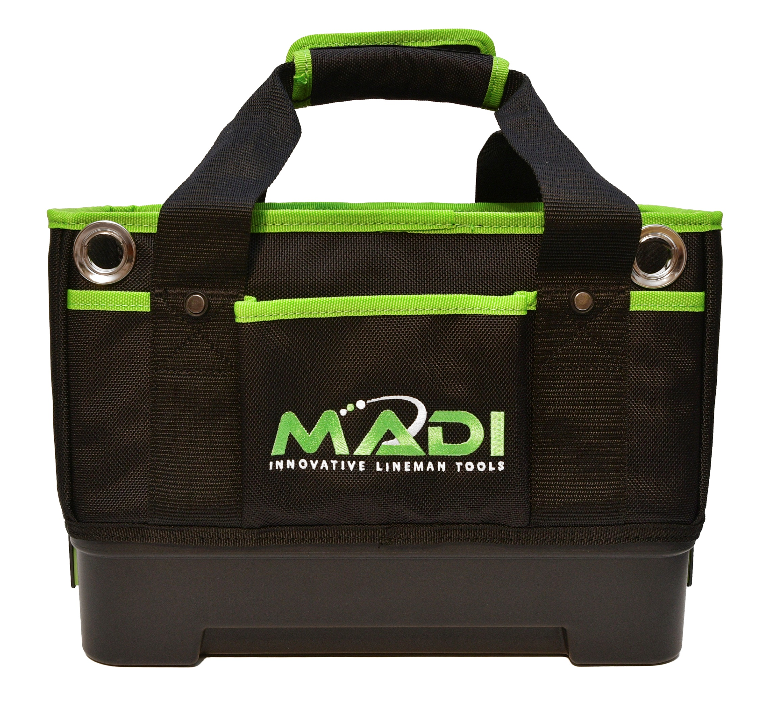
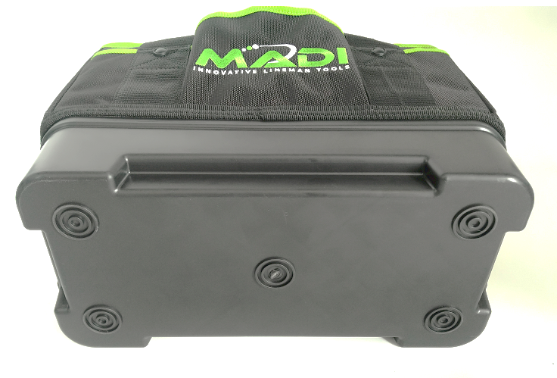
LBB-1: MADI Lineman Bucket Bag
Features & Benefits:
12 total pockets - 6 Inner & 6 outer dividers for key tools
Rugged bottom for durability and structural integrity
Made of heavy duty 1680D Ballistic Nylon for maximum durability
Material is 100% water resistant & puncture resistant up to 80 lbs.
Ideal for carrying and transporting underground and overhead tools
Two holes on the front for large bucket hooks
Side view – 7” Wide
Inside view – 6 Pockets
14” Length x 7” Width x 13” Height
Convenience, Organization and Protection
Rugged bottom protection

